Slide 1

Heart Disease Analysis and Prediction
組別：第5組
指導教授：蔡孟勳教授
組員：4110029026 林瑋成、 4109066033 魏才金

Slide 2
01
02
TABLE OF CONTENTS
03
04
05
Dataset Introduction
Data Analysis & Pre-processing
Modeling
Evaluation and Conclusion
References

Slide 3
01
02
TABLE OF CONTENTS
03
04
05
Dataset Introduction
Data Analysis & Pre-processing
Modeling
Evaluation and Conclusion
References

Slide 4
The heart disease dataset, obtained in 1988, contains medical information of patients who have undergone clinical testing for heart disease.
Number of Observations: 1025
Number of Attributes: 14
Dataset
Introduction

Slide 5

Research Motivation & Purpose
Heart disease is often among the top ten leading causes of death for the Taiwanese population
Sudden and without warning, heart disease often results in direct fatalities when it occurs
To identify key risk factors associated with heart disease
Develop models that accurately predict the presence or absence of heart disease

Slide 6

Introduction to SDGs Used
3. Good Health and Well-Being
10. Reduced Inequalities
Ensure healthy lives and promote well-being for all at all ages
Reduce inequalities within and among countries

Slide 7
SDG 3: Good Health and Well-being
This dataset can aid in the development of accurate predictive models and improve our understanding of heart disease.
better diagnosis & treatment
prevention of this critical health issue

Slide 8
SDG 10: Reduced Inequalities
Analyzing the data can help identify patterns and risk factors specific to different demographic groups.
reduce the incidence of heart disease among vulnerable populations
promote health equity and reduce health inequalities

Slide 9
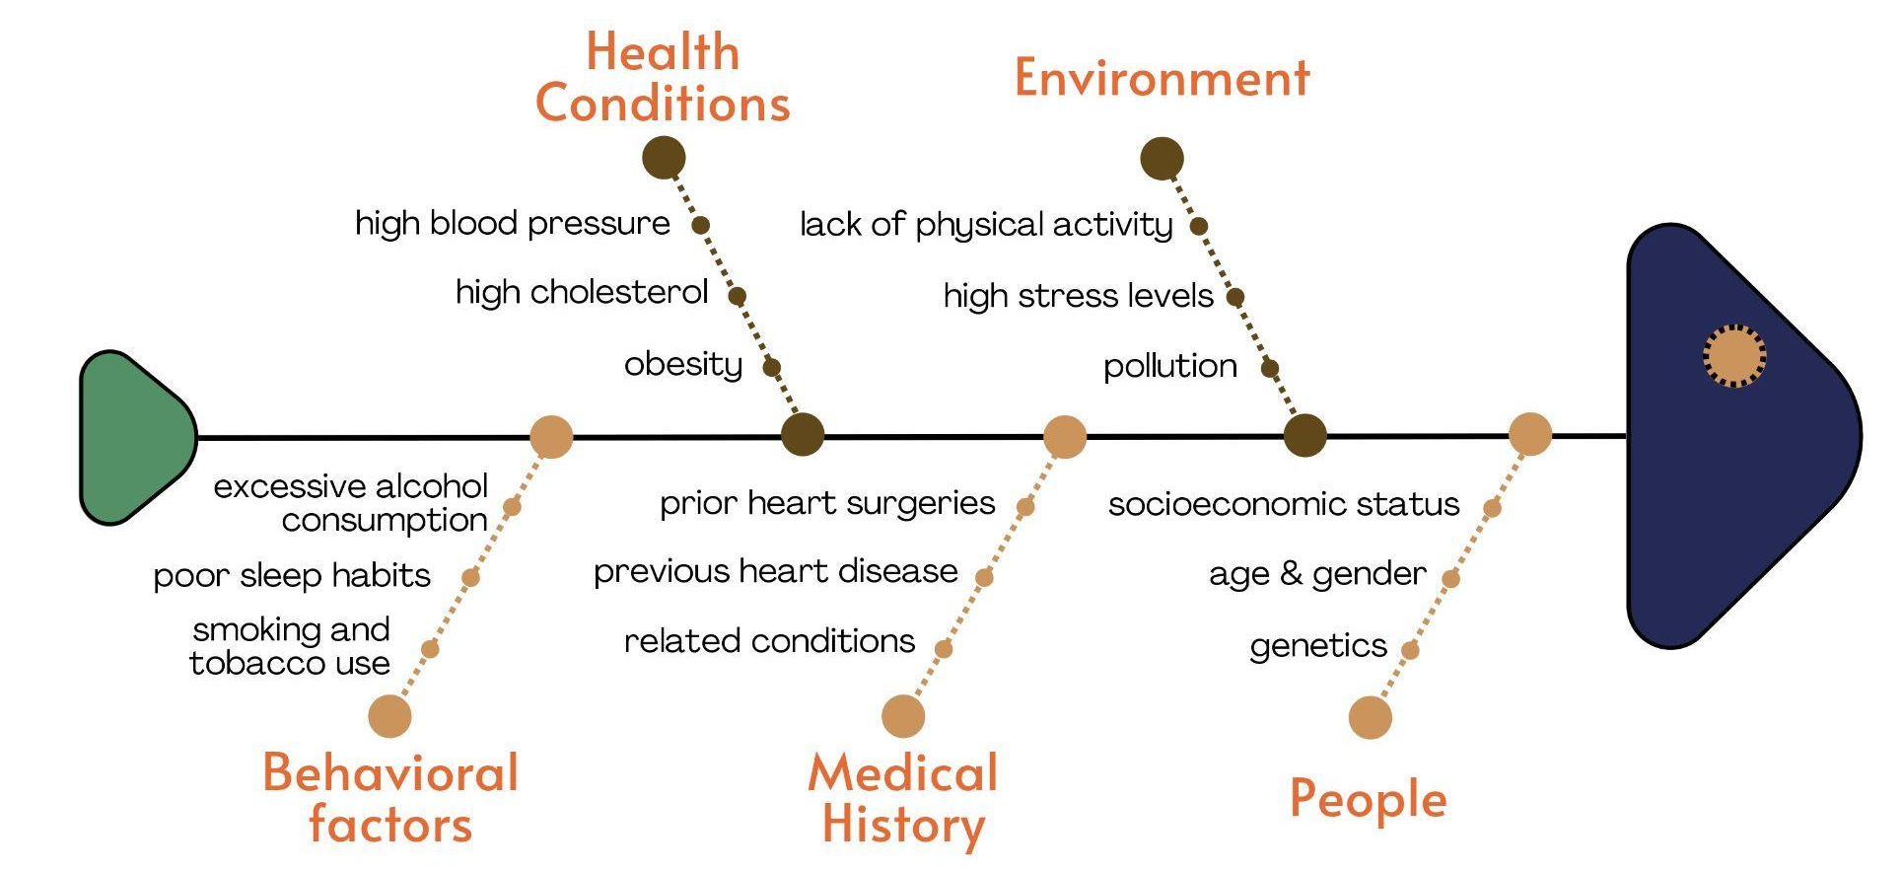
Fishbone Diagram - Factors

Slide 10
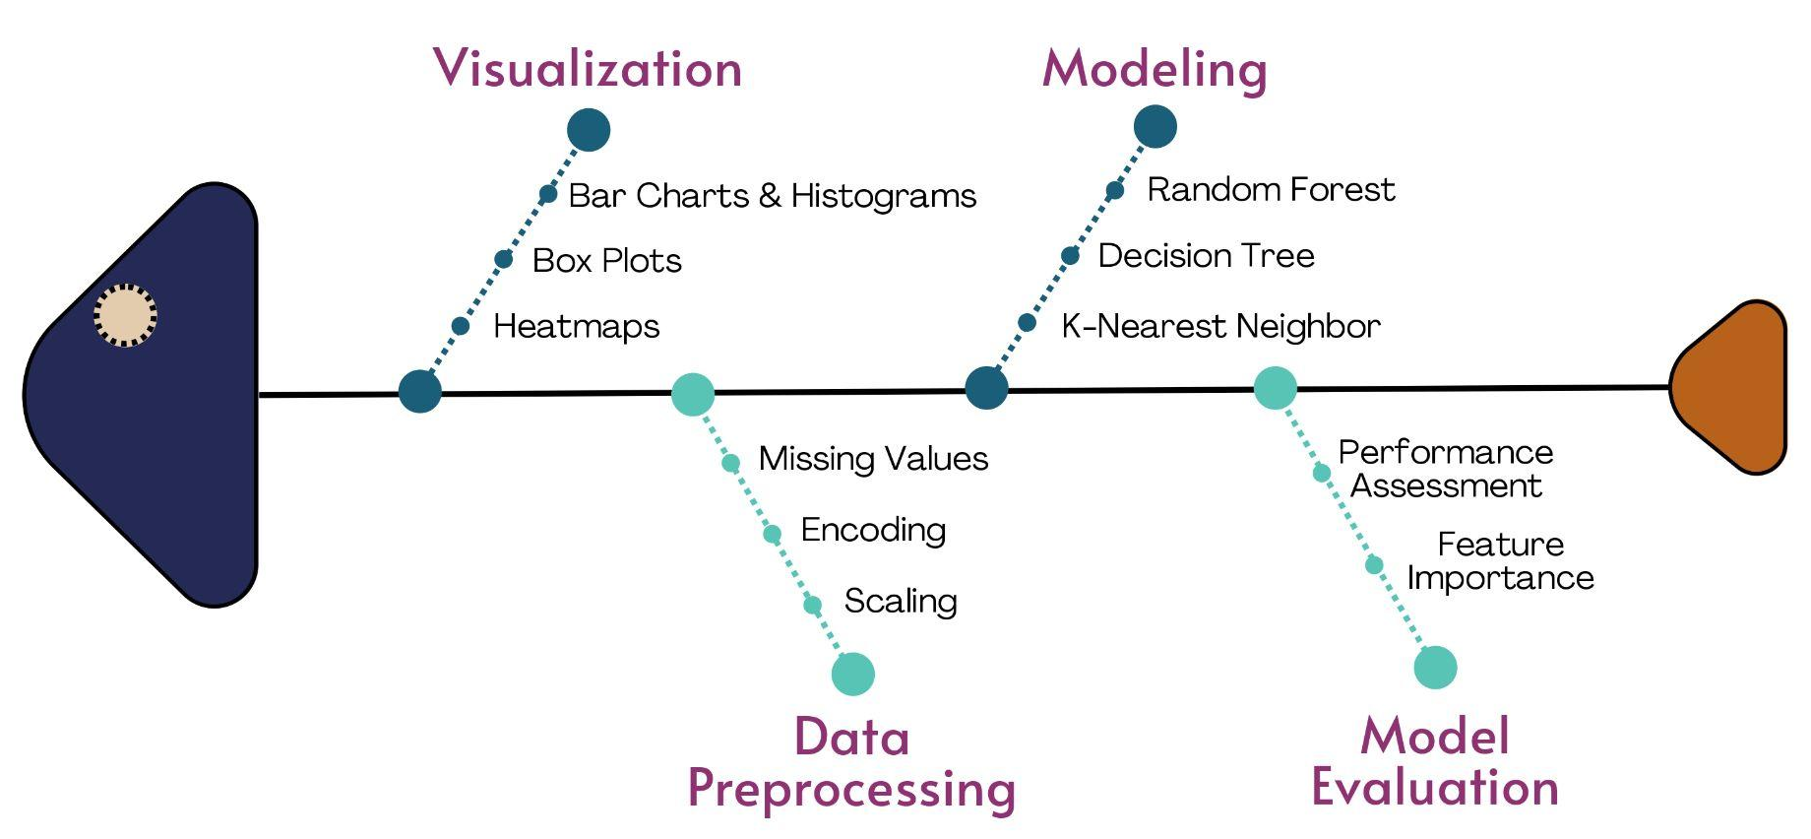
Fishbone Diagram - Solutions

Slide 11
Data Attributes
Name | 中文名稱 | Information
age | 年齡 | numerical
sex | 性別 | 0 = female 1 = male
cp | 胸部疼痛類型 | 0 = Typical angina 1 = Atypical angina 2 = Non-anginal pain 3 = Asymptomatic
trestbps | 靜息血壓 | numerical
chol | 膽固醇 | numerical
fbs | 空腹血糖 | If > 120 mg/dl: 0= false 1 = true
restecg | 靜息心電圖測量 | 0 = normal 1 = abnormality 2 = left ventricular hypertrophy
Name | 中文名稱 | Information
thalach | 達到的最大心率 | numerical
exang | 運動誘發心絞痛 | 0 = false 1 = true
oldpeak | 運動引起的S-T下降相較於休息 | numerical
slope | 最高S-T段的斜率 | 0 = up sloping 1 = flat 2 = down sloping
ca | 主要血管數量 | 0-4
thal | 地中海貧血 (一種先天性貧血) | 0 = NULL 1 = fixed defect 2 = normal blood flow 3 = reversible defect
target | 心臟病 | 0 = false 1 = true

Slide 12
01
02
TABLE OF CONTENTS
03
04
05
Dataset Introduction
Data Analysis & Pre-processing
Modeling
Evaluation and Conclusion
References

Slide 13

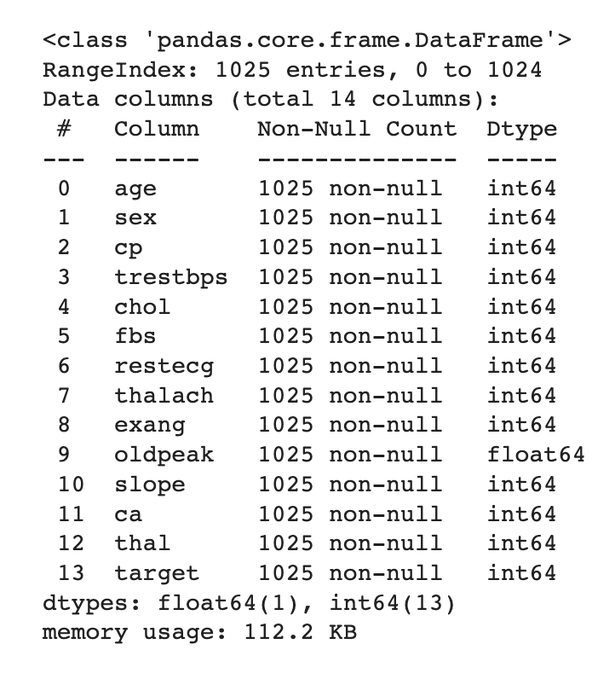
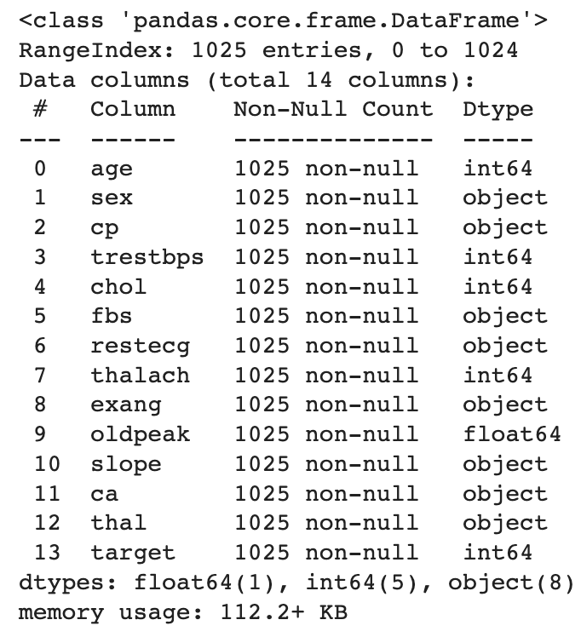
Fixing the Data Types
Notes:
(the red attributes are categorical) To make the data visualization easier, we change the categorical attributes from int or float to object.

Slide 14
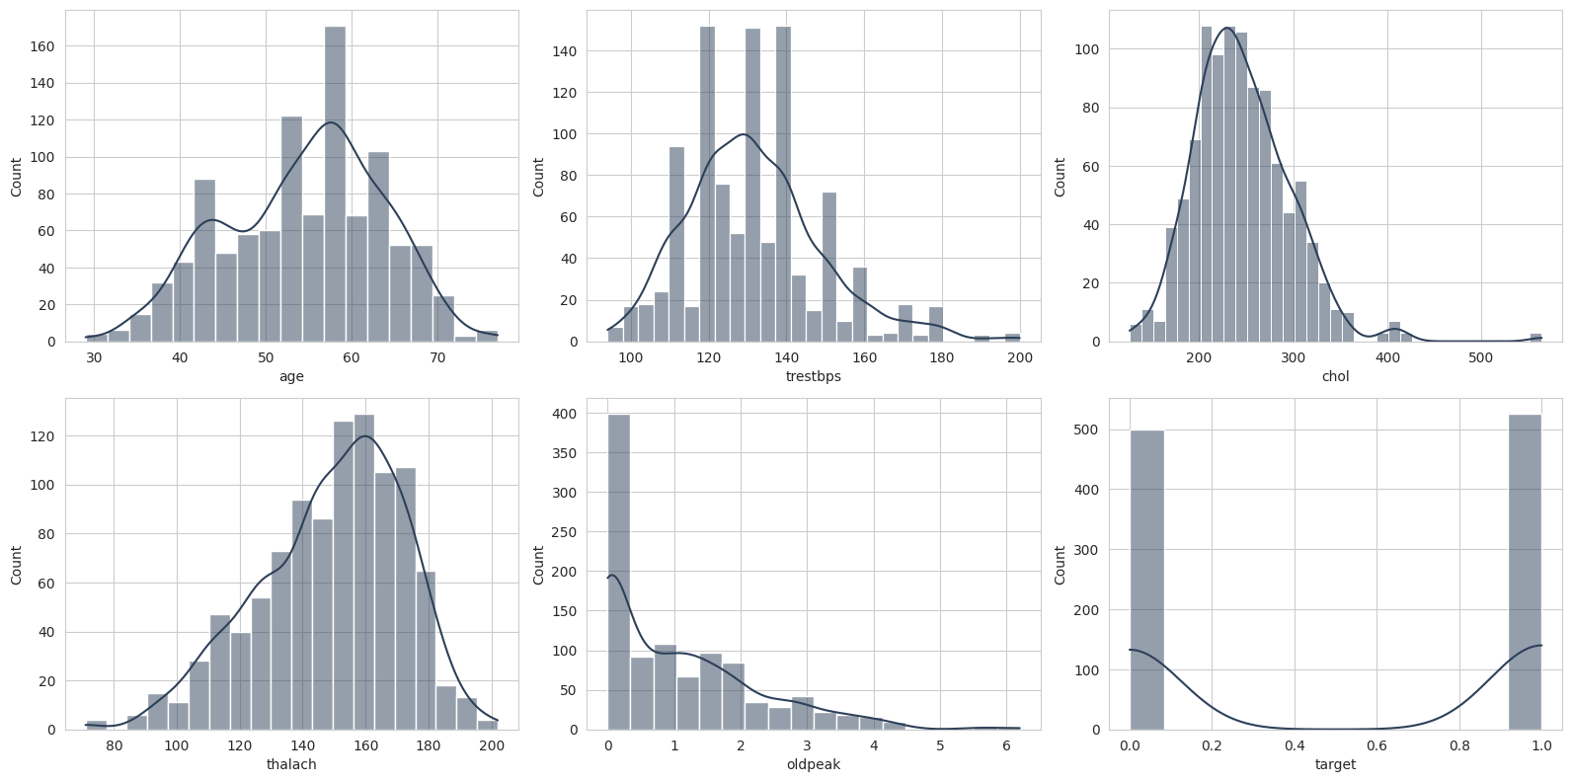
Numerical Data
Notes:
Histogram for numerical data

Slide 15
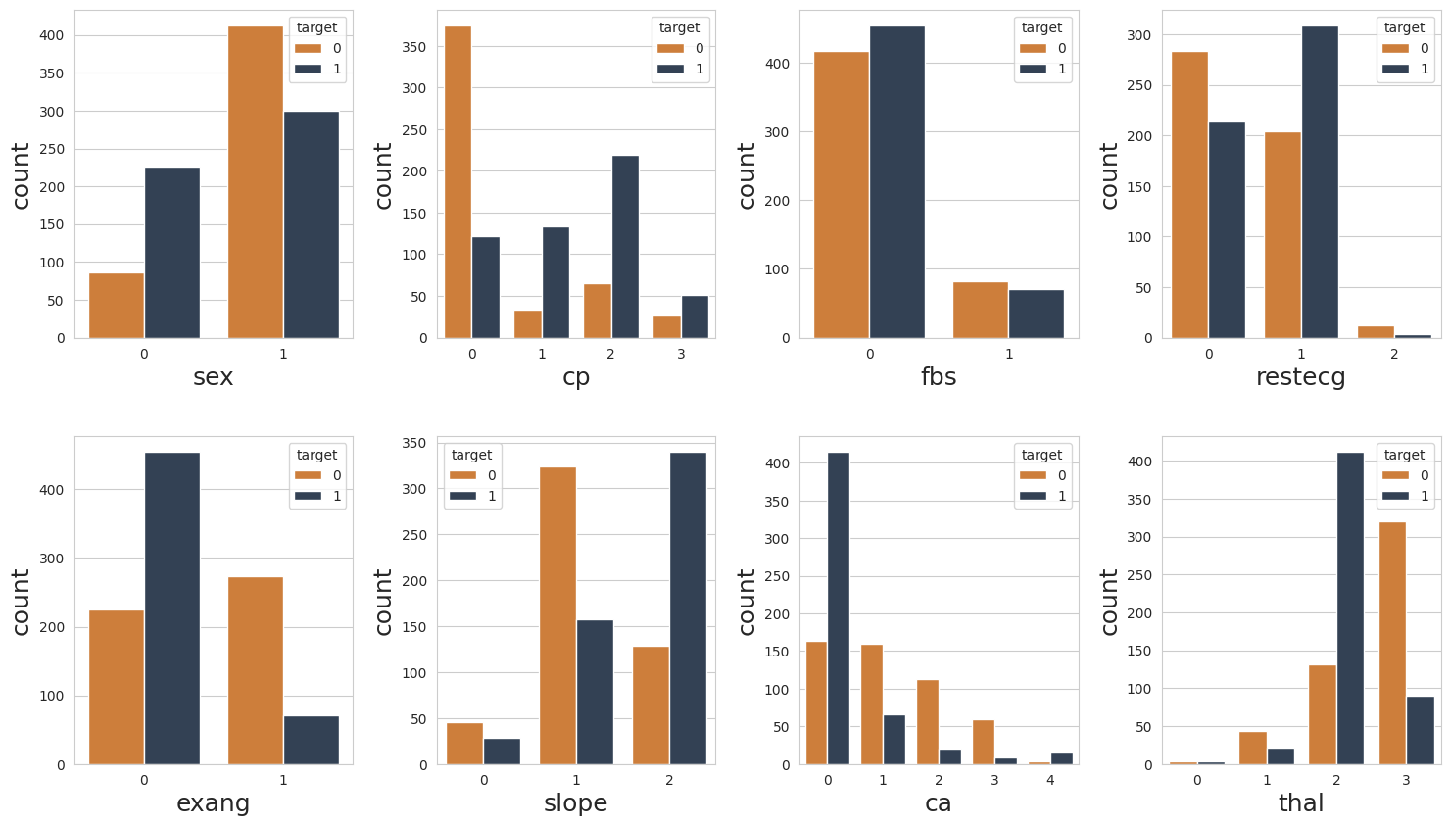
Categorical Data
Notes:
Bar Chart

Slide 16
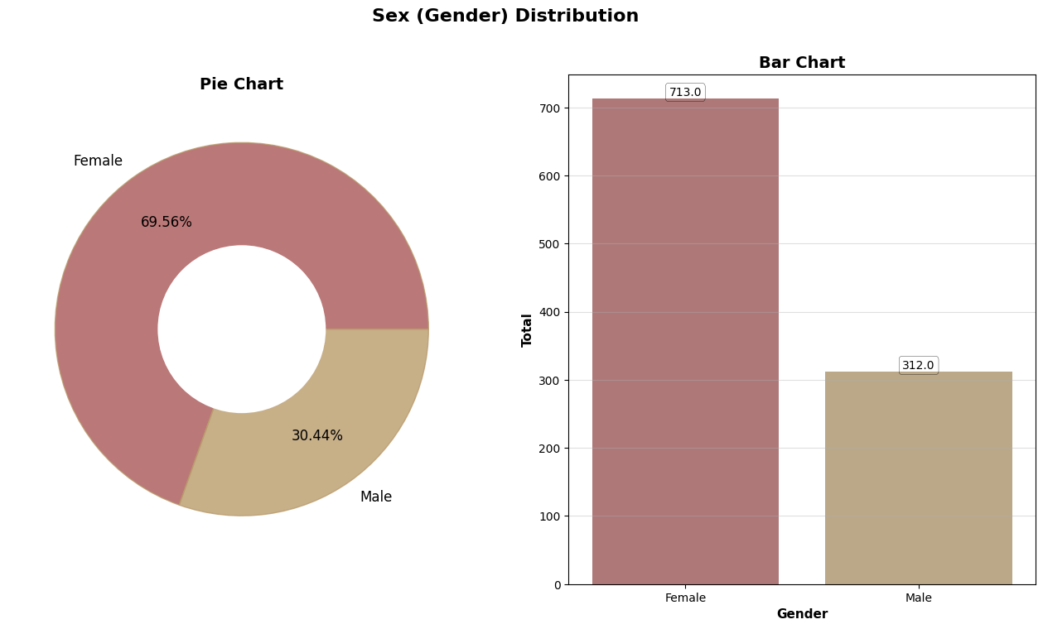
sex 性別

Slide 17
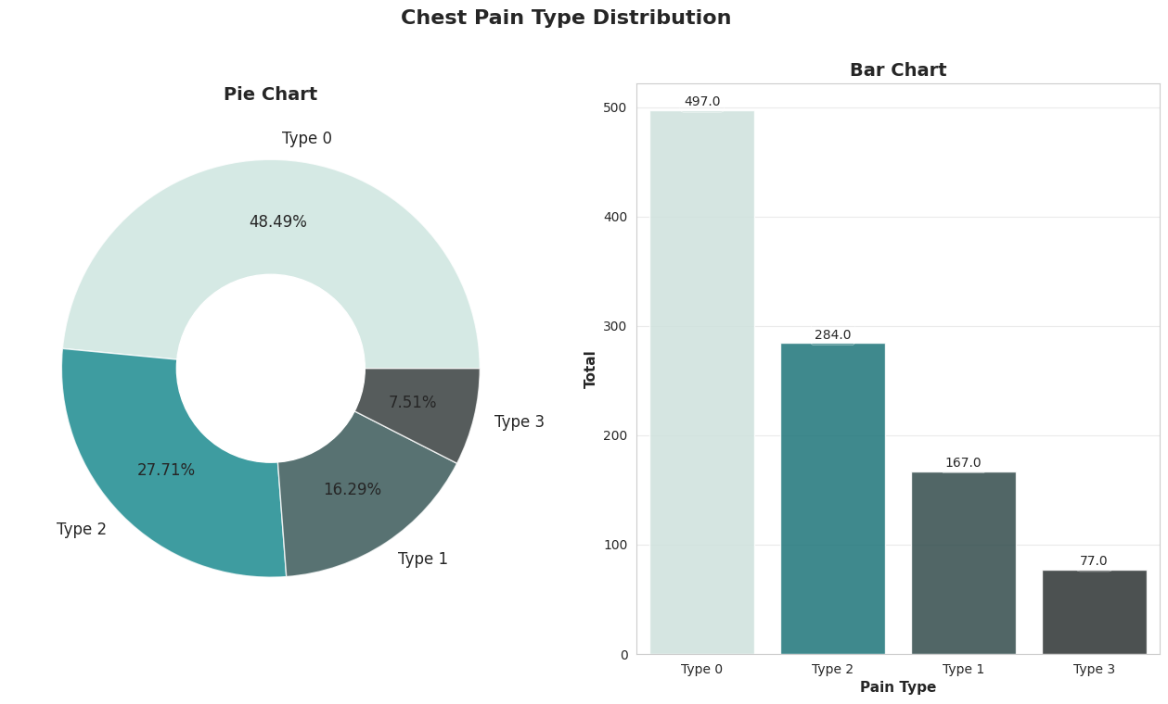
cp 胸部疼痛類型
0 = Typical angina
1 = Atypical angina
2 = Non-anginal pain
3 = Asymptomatic

Slide 18
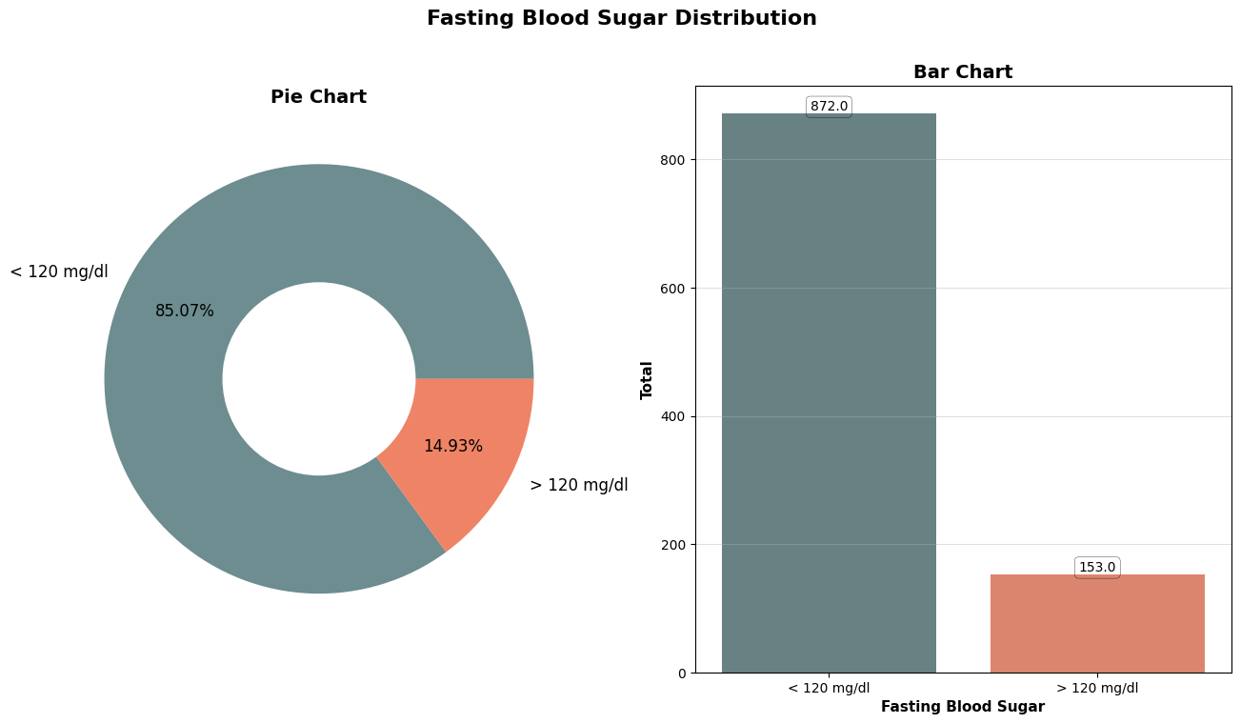
fbs 空腹血糖

Slide 19
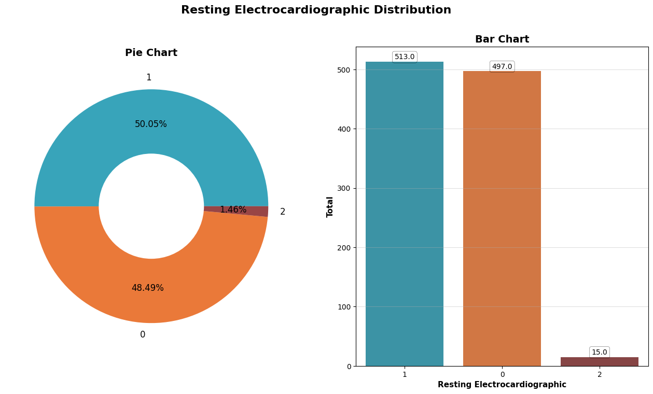
restecg 靜息心電圖測量
0 = normal
1 = abnormality
2 = left ventricular hypertrophy

Slide 20
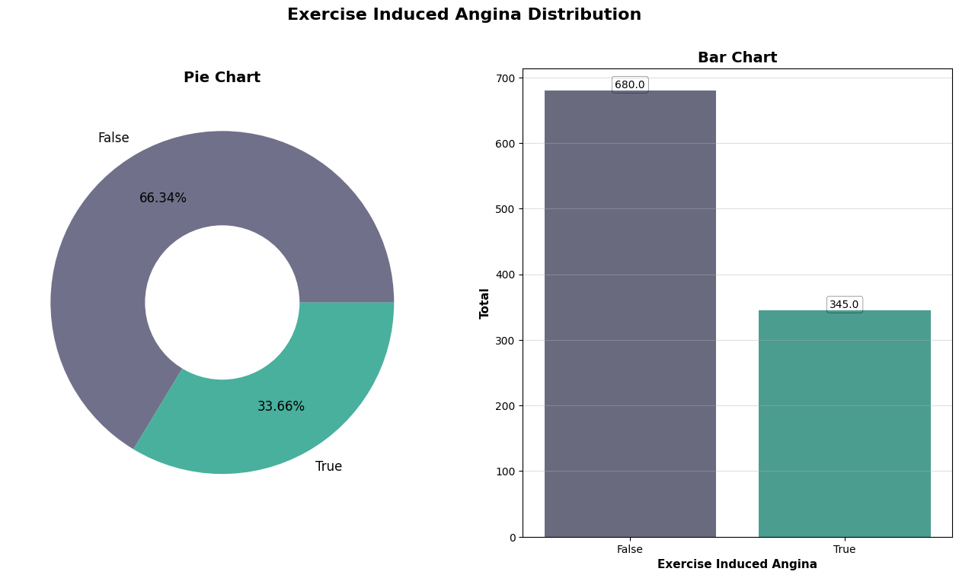
exang 運動誘發心絞痛

Slide 21
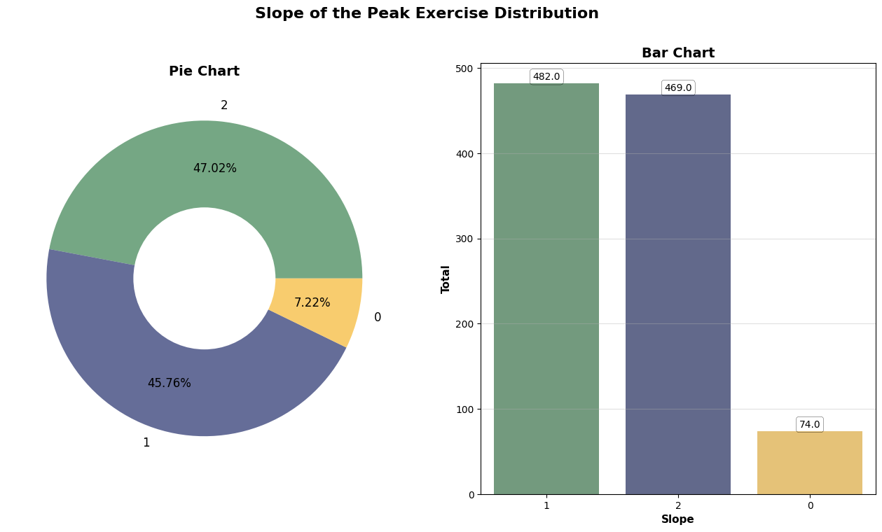
slope 最高S-T段的斜率
0 = up sloping
1 = flat
2 = down sloping

Slide 22
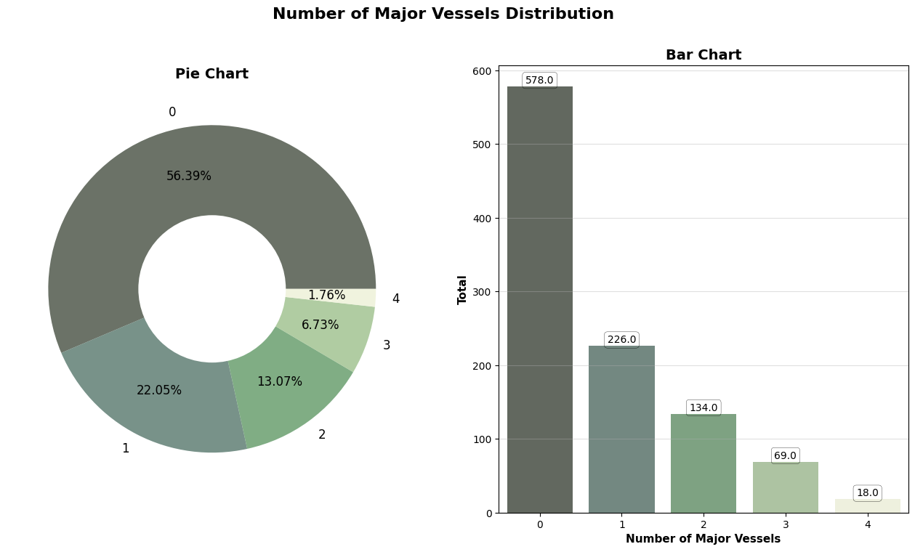
ca 主要血管數量

Slide 23
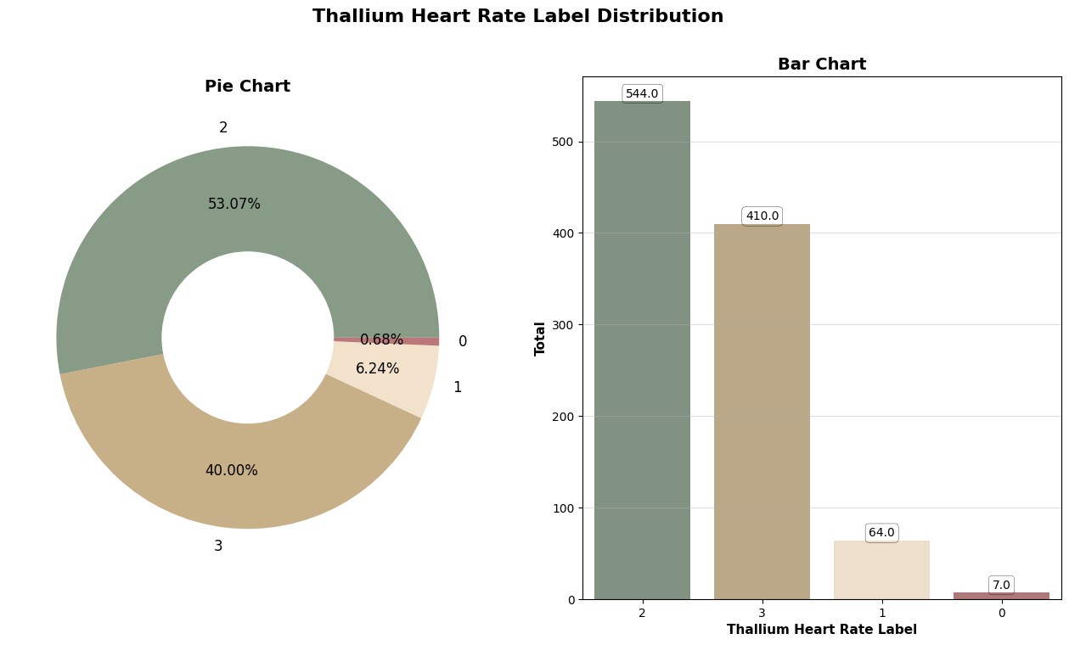
thal 地中海貧血
0 = NULL
1 = fixed defect
2 = normal blood flow
3 = reversible defect

Slide 24
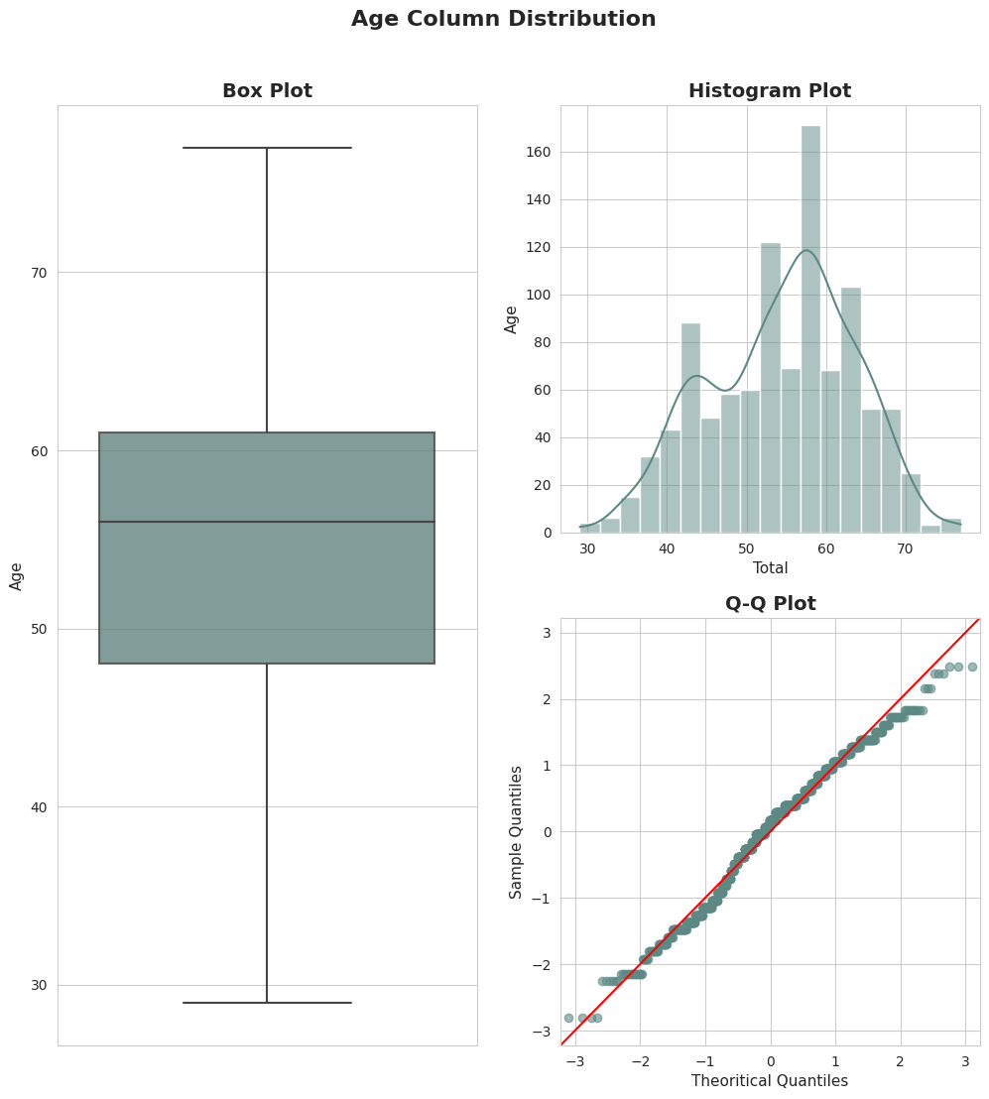
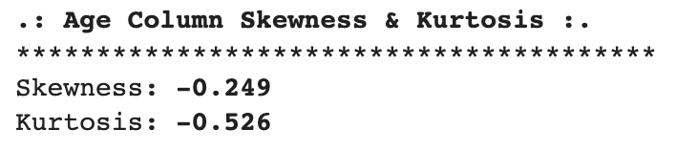
age
年齡

Slide 25
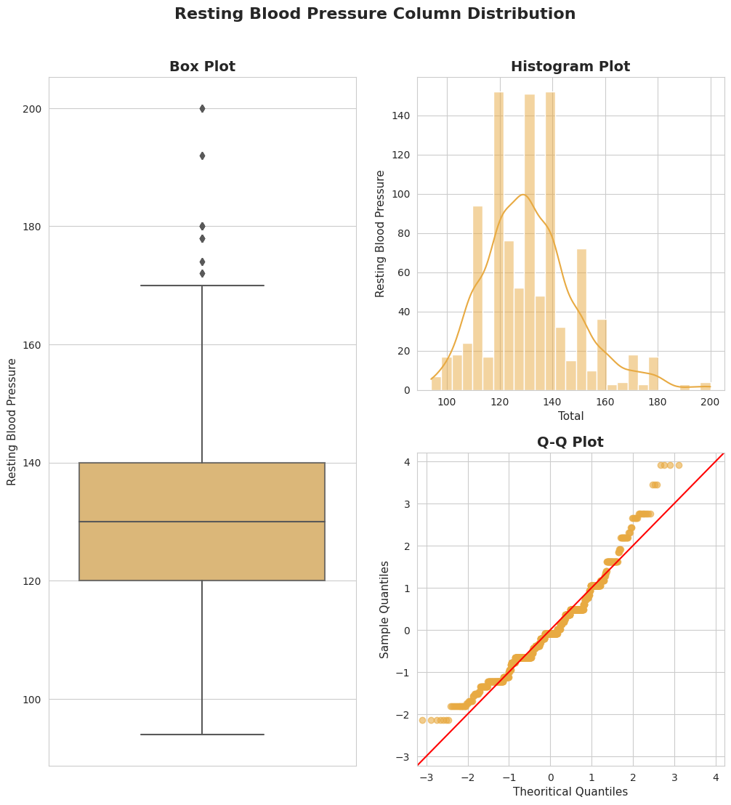
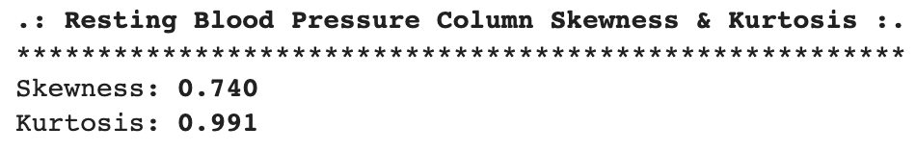
trestbps
靜息血壓

Slide 26
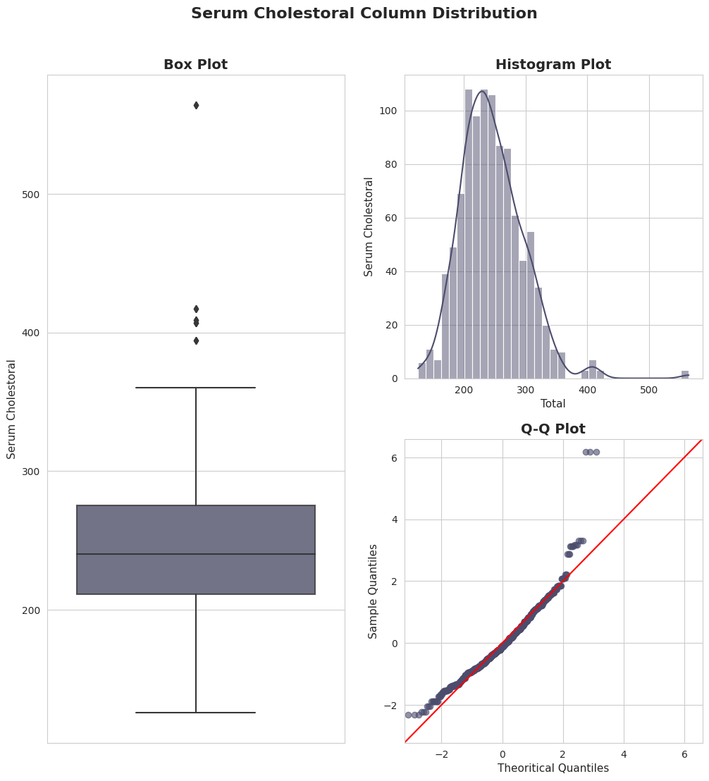
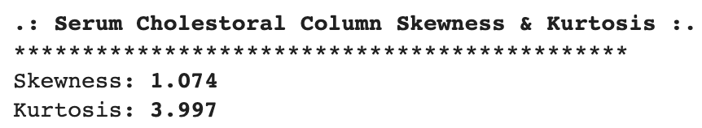
chol
膽固醇

Slide 27
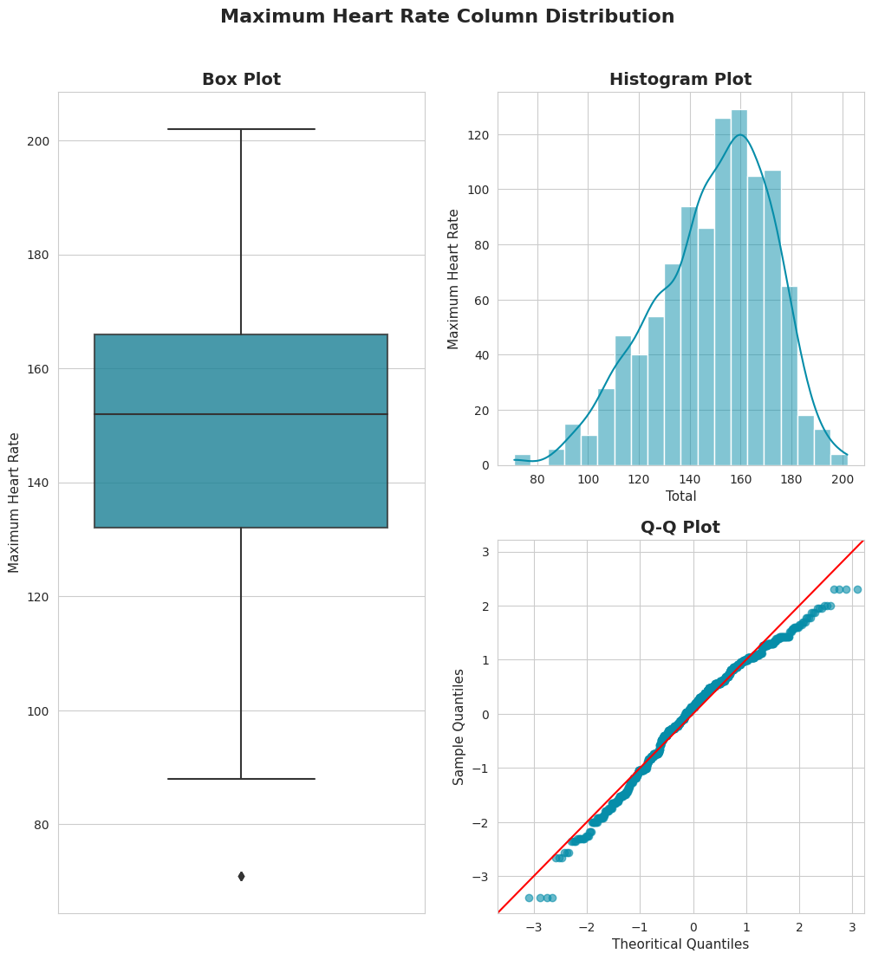
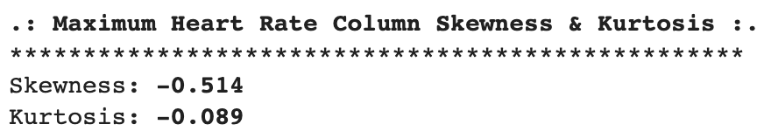
thalach
達到的最大心率

Slide 28
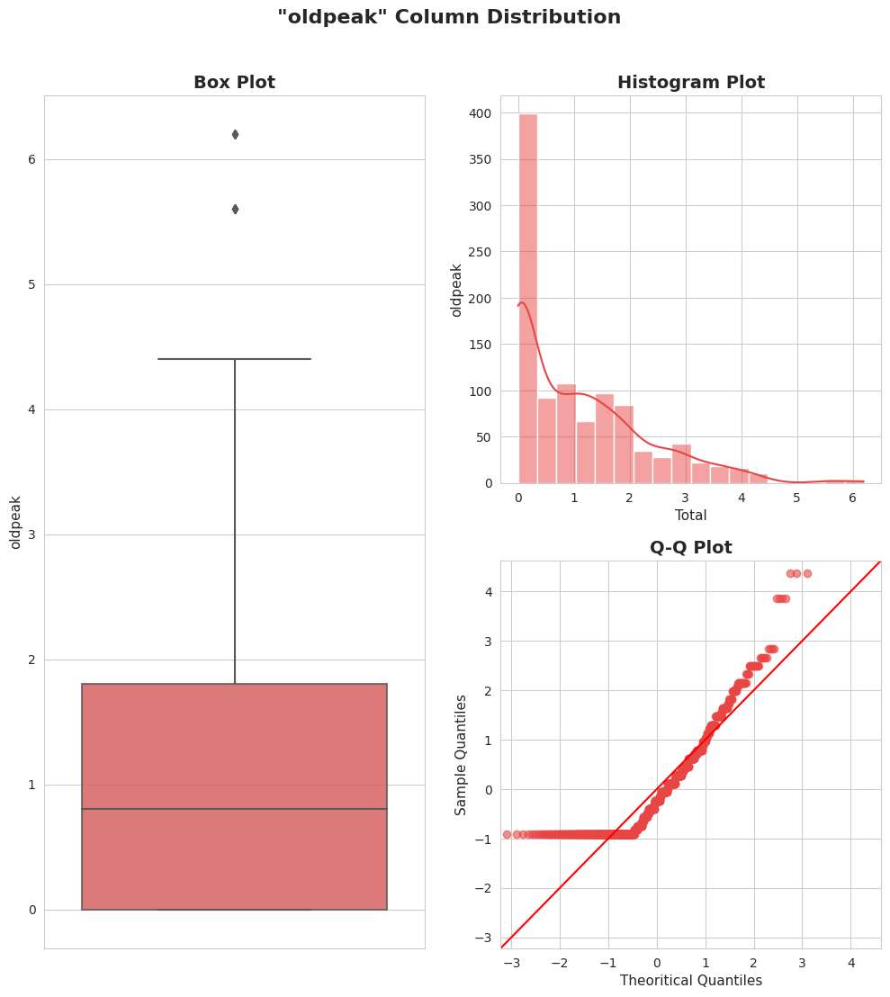
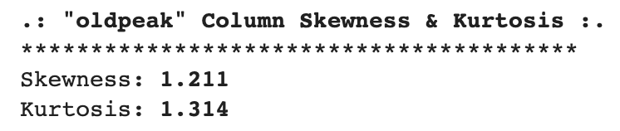
oldpeak
運動引起的S-T下降相較於休息

Slide 29
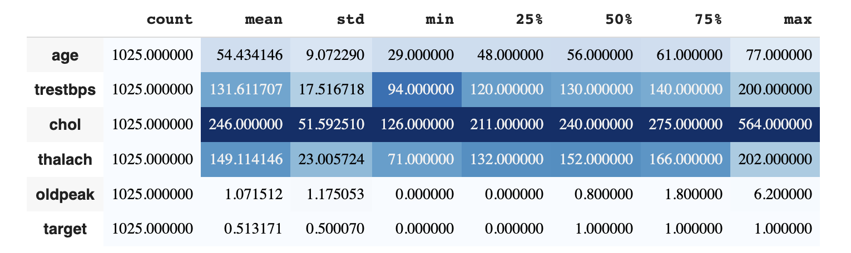

Data Analysis - Descriptive Statistics
Notes:
This descriptive statistics is for our numerical attributes,
count are the total observations Means Std = Min amount = 1st, 2nd, 3rd Quartile =

Slide 30
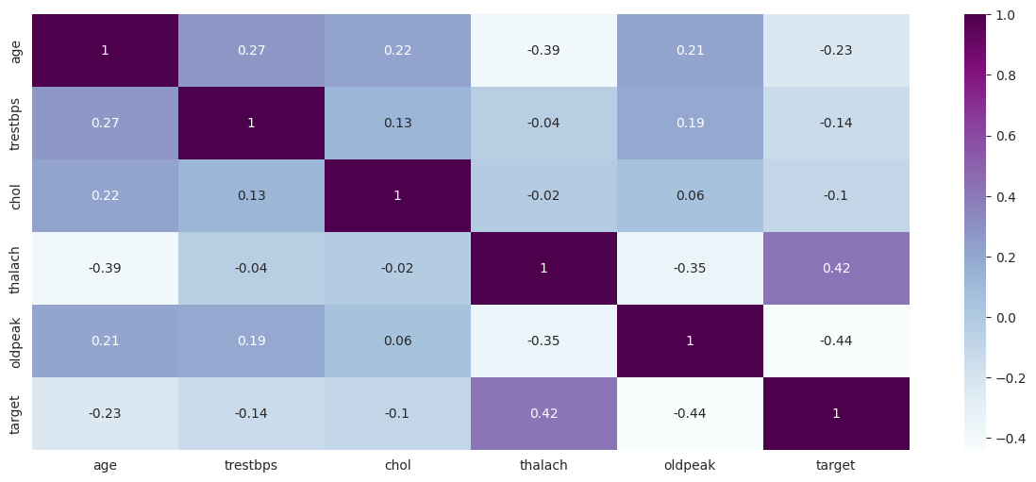
Data Analysis - Correlation heatmap
Notes:
Thal = 0.42, the higher the thal, the higher chances that person to have heart disease
Resting blood pressure, cholesterol, and ‘oldpeak(stress test depression label)’ have moderate relationship with age

Slide 31
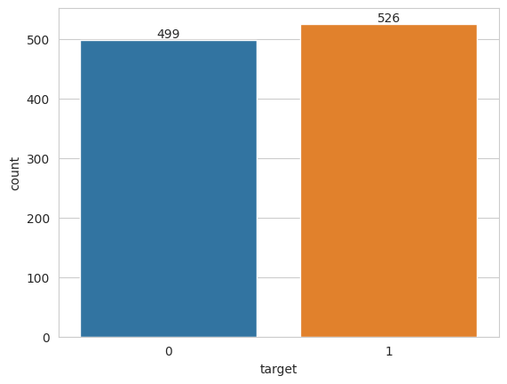
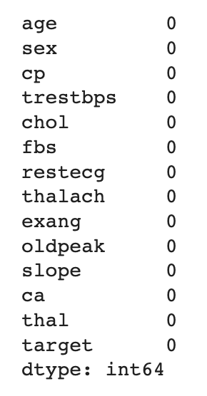
Data Pre-processing(1)
Target is balanced & No missing values

Slide 32

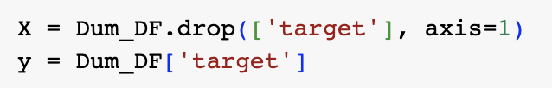
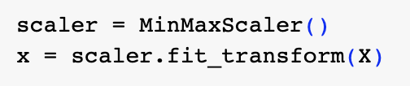
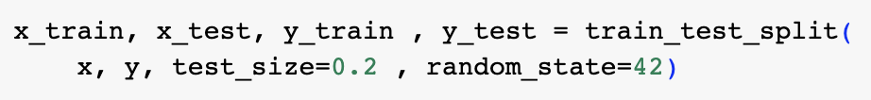
Data Pre-processing(2)
1. One-Hot Encoding
2. Normalization using Min-Max Method
3. Splitting Dataset into 80:20
Notes:
1. One-Hot Encoding is a technique used in data Pre-processing to convert categorical variables into a numerical representation that can be used for machine learning algorithms.
2. Separating Dependent Features, and then perform
3. Normalization using Min-Max Method
4.The dataset will be splitted into 80:20 ratio (80% training and 20% testing).

Slide 33
01
02
TABLE OF CONTENTS
03
04
05
Dataset Introduction
Data Analysis & Pre-processing
Modeling
Evaluation and Conclusion
References

Slide 34
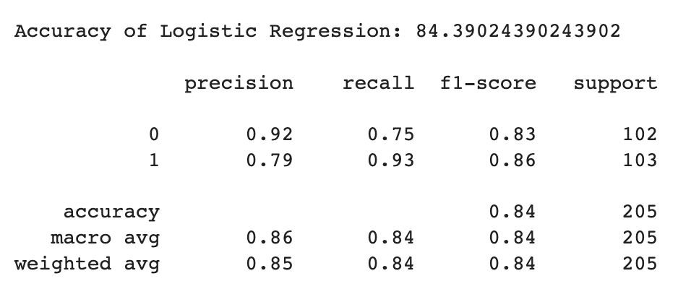
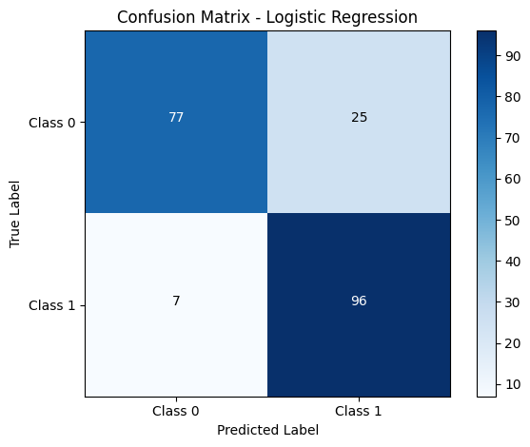
Model-1:
Logistic Regression
Accuracy = 84.4%

Slide 35
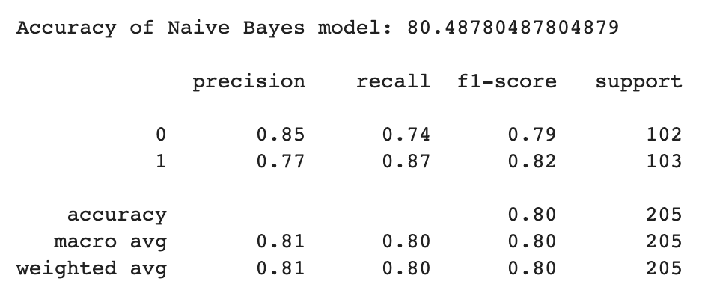

Model-2:
Naive Bayes
Accuracy = 80.5%

Slide 36
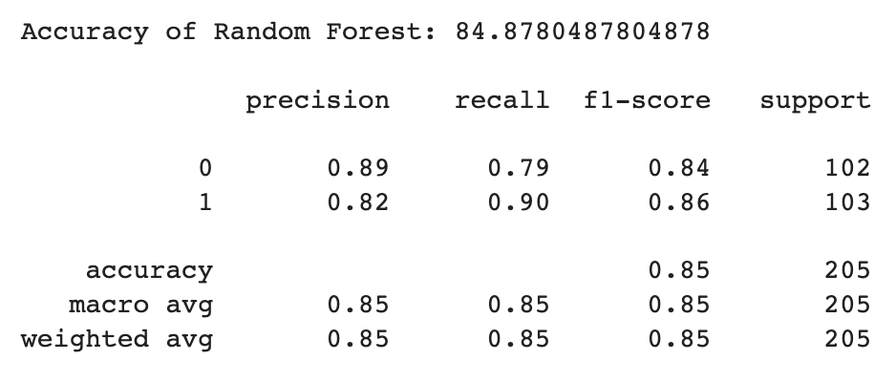

Model-3:
Random Forest
Accuracy = 84.9%

Slide 37
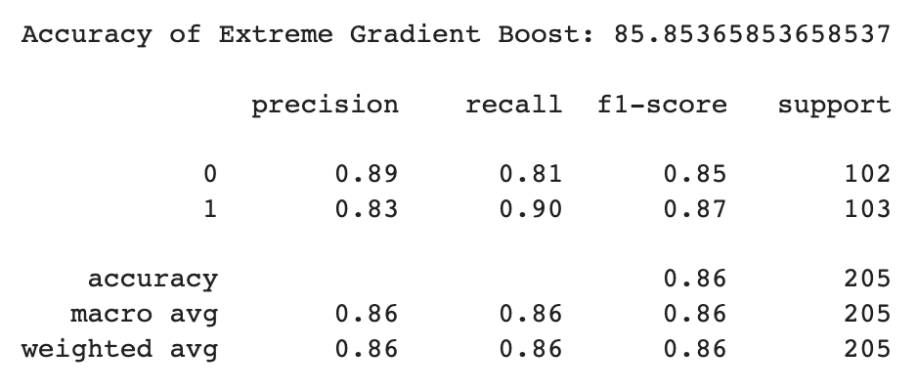
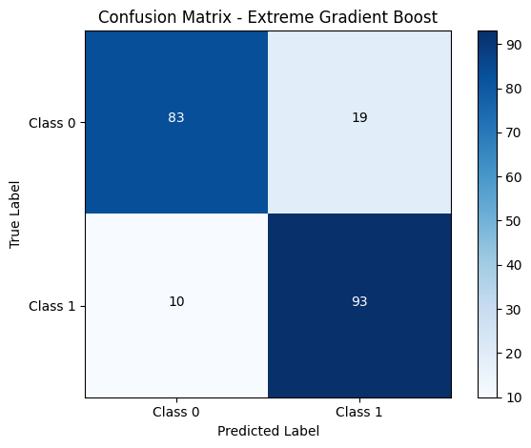
Model-4:
Extreme Gradient Boost
Accuracy = 85.9%

Slide 38

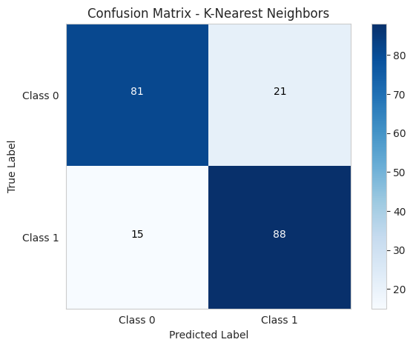
Model-5:
K-Nearest Neighbors
Accuracy = 82.4%

Slide 39
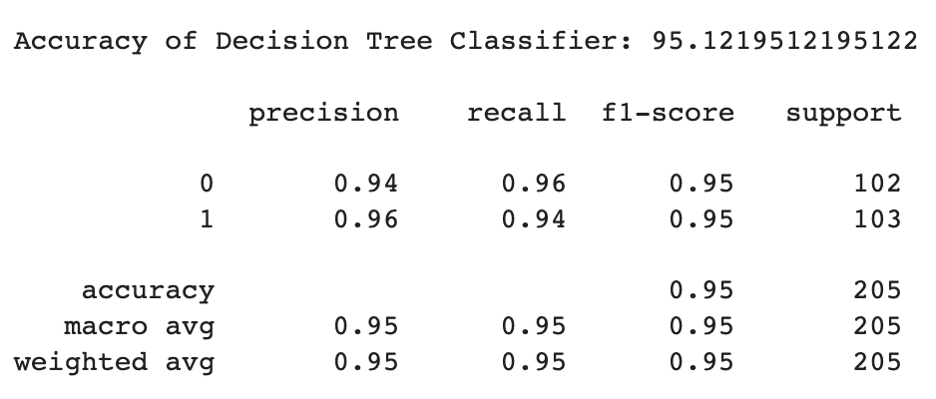
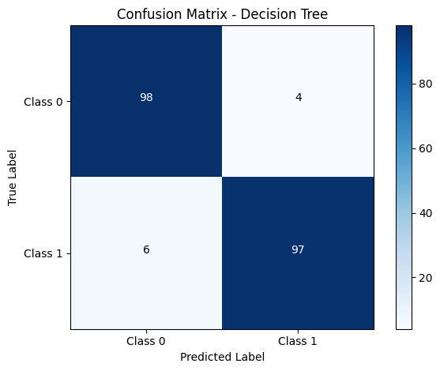
Model-6:
Decision Tree
Accuracy = 95.1%

Slide 40
01
02
TABLE OF CONTENTS
03
04
05
Dataset Introduction
Data Analysis & Pre-processing
Modeling
Evaluation and Conclusion
References

Slide 41
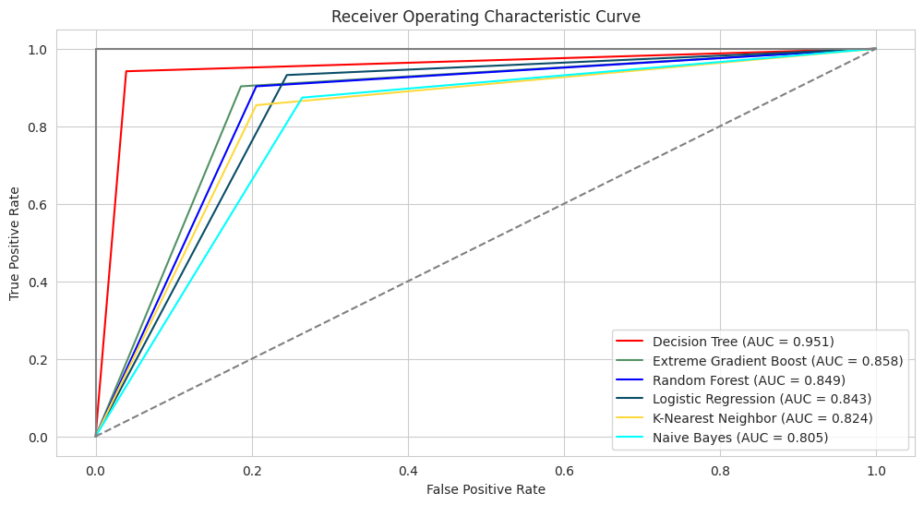
ROC Curve and AUC

Slide 42
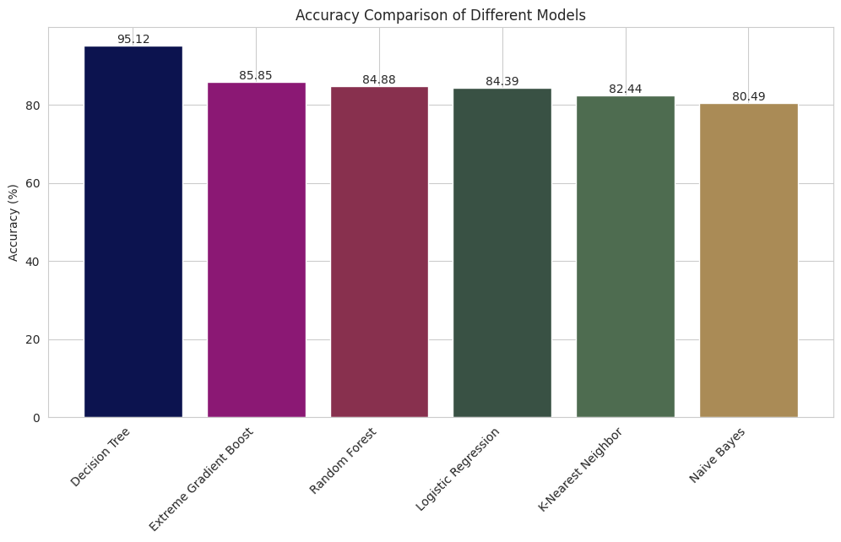
Accuracy Comparison
Notes:
Use the 4 best models to perform Features Importance

Slide 43
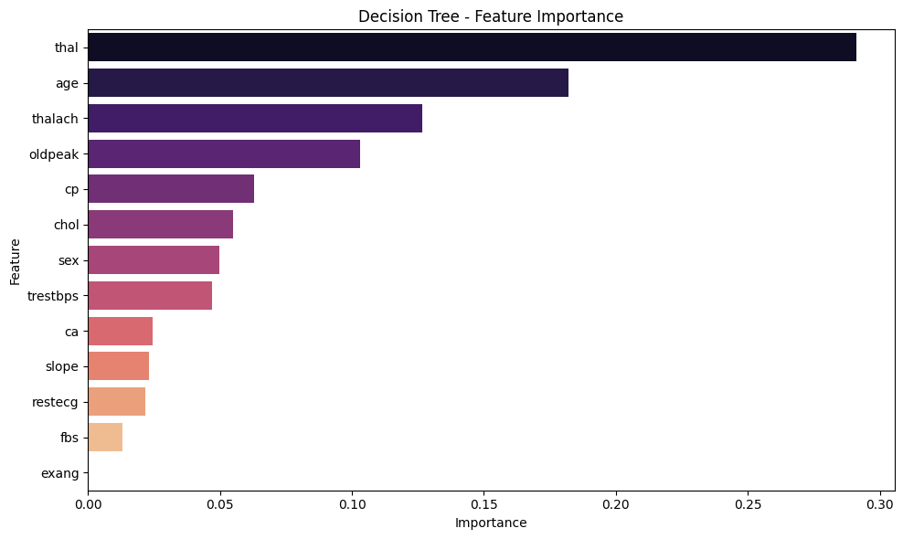
Feature Importance - Decision Tree

Slide 44
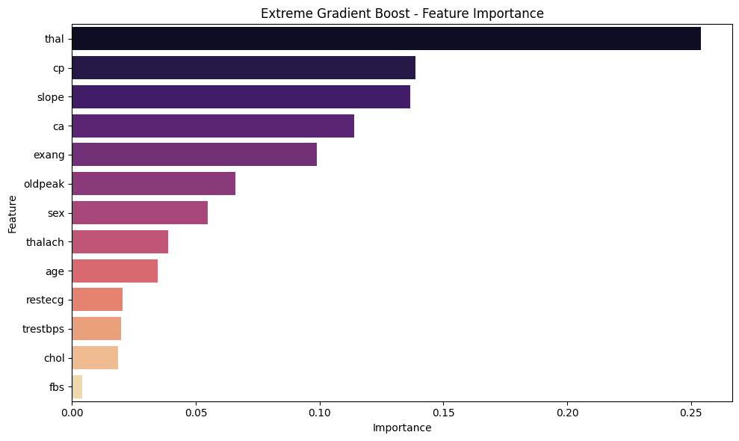
Feature Importance - Extreme Gradient Boost

Slide 45
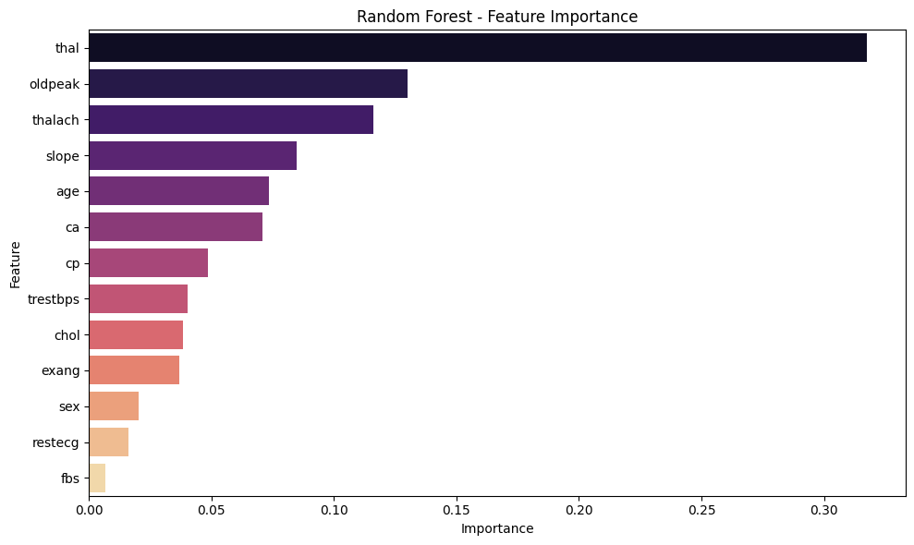
Feature Importance - Random Forest

Slide 46
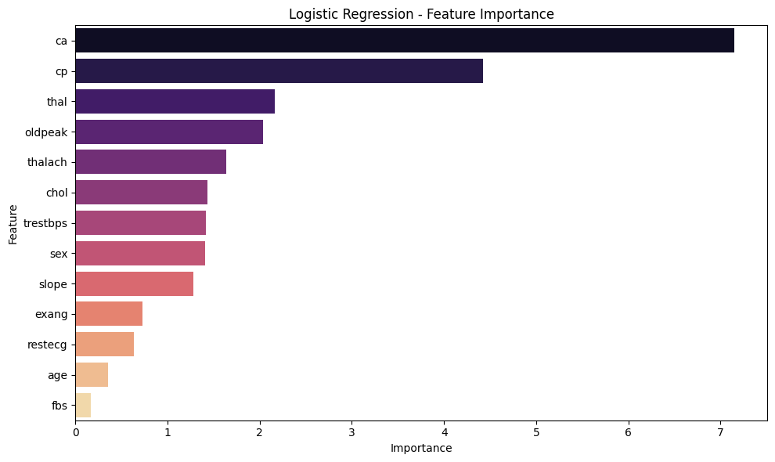
Feature Importance - Logistic Regression

Slide 47
1. Decision Tree
2. Extreme Gradient Boost
4. Logistic Regression
3. Random Forest
1st: thal
2nd: age
3rd: thalach
4th: oldpeak
1st: thal
2nd: cp
3rd: slope
4th: ca
Feature
Importance
1st: thal
2nd: oldpeak
3rd: thalach
4th: slope
1st: ca
2nd: cp
3rd: thal
4th: oldpeak

Slide 48
Among the models evaluated, the decision tree model can be considered the most reliable and accurate in predicting heart disease in the given dataset.
Based on the analysis of the dataset, it was found that the attributes Thallium Heart Rate Label(thal), Maximum Heart Rate(thalach), and Chest Pain Type(cp) play the most critical role in predicting heart disease.
Conclusion

Slide 49
01
02
TABLE OF CONTENTS
03
04
05
Dataset Introduction
Data Analysis & Pre-processing
Modeling
Evaluation and Conclusion
References

Slide 50
References
Heart Disease Dataset: https://www.kaggle.com/datasets/johnsmith88/heart-disease-dataset
Heart Disease Dataset - Discussion: https://www.kaggle.com/datasets/johnsmith88/heart-disease-dataset/discussion/401933
Slidesgo Template: https://slidesgo.com/theme/engineering-project-proposal
Predictive Model Construction and Classification for Heart Disease: http://ielab.ie.nthu.edu.tw/109_IIE_project/2/109IIE_proj2_1_word.pdf

Slide 51

THANKS

